Slide 1
Patterns Evaluation in Data Mining
DSA2040

Slide 2
Pattern Evaluation
In data mining, pattern evaluation is the process of assessing the quality of discovered patterns. This process is important in order to determine whether the patterns are useful and whether they can be trusted.

Slide 3
Why is Pattern Evaluation Important?
To ensure that the patterns are reliable and accurate.
To identify the most useful and actionable patterns.
To compare different data mining algorithms and models.
To avoid overfitting and to ensure that the patterns generalize to new data.

Slide 4
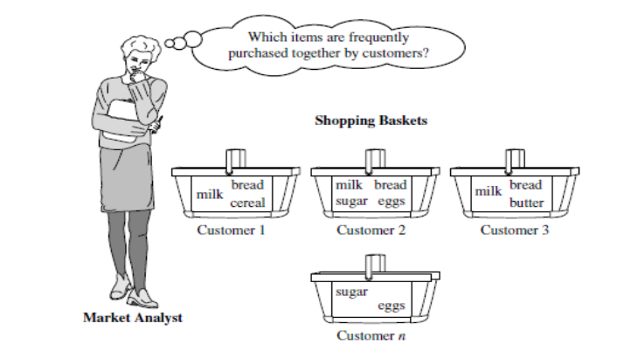
Market Basket Analysis

Slide 5
Market Basket Analysis
A typical example of frequent itemset mining is market basket analysis. This process analyzes customer buying habits by finding associations between the different items that customers place in their “shopping baskets”
The discovery of these associations can help retailers develop marketing strategies by gaining insight into which items are frequently purchased together by customers. For instance, if customers are buying milk, how likely are they to also buy bread (and what kind of bread) on the same trip to the supermarket? This information can lead to increased sales by helping retailers do selective marketing and plan their shelf space.

Slide 6
Association Rule
An association rule is a statement that describes a relationship between two or more itemsets. The rule is expressed in the form "if X, then Y", where X and Y are itemsets of medical conditions, symptoms, or risk factors. The support of the rule is the percentage of patients in the dataset who have both X and Y. The confidence of the rule is the percentage of patients who have X who also have Y.
Example:
Association rule: If a patient has hypertension, then they are also likely to have diabetes.
Support: 50%
Confidence: 66%
This rule means that 50% of the patients in the dataset who have hypertension also have diabetes. It also means that 66% of the patients in the dataset who have hypertension are likely to have diabetes.

Slide 7
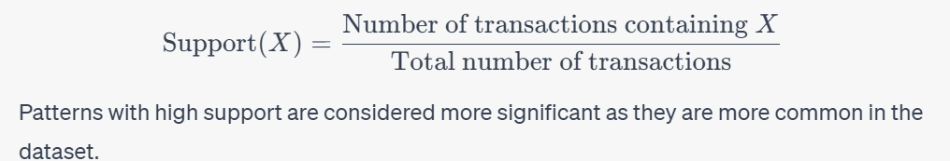
Basic Concepts-Support
Support is a measure of how frequently a pattern appears in the dataset. It is defined as the proportion of transactions or records in the dataset that contain the pattern. Mathematically, it is represented as:

Slide 8
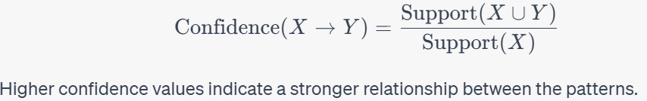
Confidence:
Confidence measures the strength of association between two patterns in an association rule. It is defined as the conditional probability of one pattern given another. Mathematically, it is represented as:

Slide 9
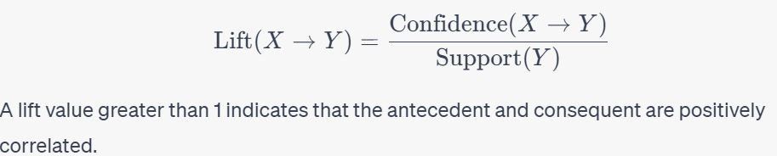
Lift
Lift is a measure that compares the likelihood of the occurrence of the antecedent and consequent of a rule under the assumption of independence. It is calculated as:

Slide 10
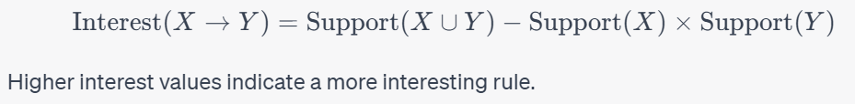
Interest
Interest: Interest is a measure used for assessing the significance of association rules. It is defined as the difference between the observed support and the expected support under independence. Mathematically, it is represented as:

Slide 11
How to use support and confidence to evaluate association rules
To identify strong association rules. A strong association rule is a rule with high support and high confidence. This means that the rule occurs frequently in the dataset and that the antecedent of the rule is a strong predictor of the consequent of the rule.
To filter out weak association rules. A weak association rule is a rule with low support or low confidence. This means that the rule either occurs infrequently in the dataset or that the antecedent of the rule is not a strong predictor of the consequent of the rule.

Slide 12
Example 1
If a person lives in a poor neighborhood, they are also likely to have a higher rate of chronic diseases.
The itemset is "living in a poor neighborhood" and "having a chronic disease". High support means that a large number of cases in the data include both poverty and chronic diseases.
"living in a poor neighborhood", a large percentage also includes "having a chronic disease". High confidence in this rule suggests that poverty might be a strong indicator of chronic diseases.
If people from poor neighborhoods are more likely to have chronic diseases than the general population, the lift will be greater than 1, indicating a positive association between the two.
A rule is interesting if it has a high lift and confidence, signifying a strong and potentially causal relationship, and if it reveals insights that may not be immediately obvious.

Slide 13
Implementation in R
# Create a contingency table to show the number of times each itemset occurs in the datasetcontingency_table <- table(diamonds$cut, diamonds$clarity)
# Calculate the support for each itemsetsupport <- contingency_table / sum(contingency_table)View(support)
# Calculate the confidence for each association ruleconfidence <- contingency_table[lower.tri(contingency_table)] / contingency_table[colSums(contingency_table) > 0]

Slide 14
Itemset mining in R-Support
library(ggplot2)data(diamonds)# Create a contingency table to show the number of times each itemset occurs in the dataset
contingency_table <- table(diamonds$cut, diamonds$clarity)
# Calculate the support for each
itemsetsupport <- contingency_table / sum(contingency_table)
View(support)
head(support)

Slide 15
Lift and interest
#Lift# Calculate lift
lift <- (confidence / support[colSums(contingency_table) > 0]) * 100
# Calculate interest
interest <- (support[lower.tri(contingency_table)] / support[colSums(contingency_table) > 0]) * 100
# Print the lift and interest for each association rule
print(lift)
print(interest)
View(lift)

Slide 16
Confidence
# Calculate the confidence for each association ruleconfidence <- contingency_table[lower.tri(contingency_table)] / contingency_table[colSums(contingency_table) > 0]
#The lower.tri() function is used to create a lower triangular matrix from the contingency table.
#This means that only the cells below the diagonal of the matrix are used.
print(support)
print(confidence)

Slide 17
Contigency table
The lower.tri() function is used to create a lower triangular matrix from the contingency table. This means that only the cells below the diagonal of the matrix are used.
The colSums() function is used to calculate the sum of the values in each column of the contingency table.
The contingency_table[lower.tri(contingency_table)] expression extracts the lower triangular matrix from the contingency table.
The contingency_table[colSums(contingency_table) > 0] expression extracts the rows of the contingency table that have a non-zero sum. This removes any empty rows from the table.
The contingency_table[lower.tri(contingency_table)] / contingency_table[colSums(contingency_table) > 0] expression divides the lower triangular matrix by the rows of the contingency table that have a non-zero sum. This calculates the confidence for each association rule.
The output of the code is a vector containing the confidence for each association rule. The confidence values range from 0 to 1, with a higher value indicating a stronger association between the antecedent and consequent of the rule.

Slide 18
Lift output
The lift results you provided are also very high, suggesting that the association rules they represent are much more likely to occur than expected by chance. This is consistent with the interest results, which also suggested that the association rules were very common in the dataset.
Here is a more detailed interpretation of the lift results:
The highest lift value is 1.963816e+08, which represents the association rule {Ideal} => {Good}. This means that diamonds with the clarity grade of Ideal are 196,381,600 times more likely to be considered good diamonds than expected by chance.
The next highest lift value is 3.341085e+06, which represents the association rule {Fair} => {Good}. This means that diamonds with the clarity grade of Fair are 3,341,085 times more likely to be considered good diamonds than expected by chance.
Other high lift values include the association rules {Very Good} => {Good}, {Premium} => {Good}, and {SI1} => {Good}. This is consistent with the interest results, which also suggested that diamonds with higher clarity grades are generally more likely to be considered good diamonds.

Slide 19
Lift and Antecedent rule
Lift is a measure of how much more likely the consequent of an association rule is to occur when the antecedent of the rule is present, compared to when the antecedent of the rule is not present. Lift values greater than 1 indicate that the consequent of the rule is more likely to occur when the antecedent of the rule is present.
Interest is a measure of how much more common an association rule is in the dataset, compared to all possible association rules. Interest values greater than 1 indicate that the association rule is more common in the dataset than expected by chance.

Slide 20
Applications in Epidemiology
Identifying patterns in disease co-occurrence
Developing diagnostic tools
Predicting disease risk
Identifying new treatment targets
Conducting pharmacovigilance (monitoring the safety of drugs)
Investigating outbreaks of infectious diseases

Slide 21
Pattern Mining Evaluation metrics
1. Accuracy
The accuracy of a data mining model is a measure of how correctly the model predicts the target values. The accuracy is measured on a test dataset, which is separate from the training dataset that was used to train the model.
2. Classification Accuracy
This measures how accurately the patterns discovered by the algorithm can be used to classify new data. This is typically done by taking a set of data that has been labeled with known class labels and then using the discovered patterns to predict the class labels of the data. The accuracy can then be computed by comparing the predicted labels to the actual labels.

Slide 22
Pattern Mining Evaluation metrics
Precision is the percentage of correct predictions made by the model for a particular class, and recall is the percentage of instances of a particular class that was correctly predicted by the model
Confusion matrix is a table that shows the number of correct and incorrect predictions made by the model for each class. This can be a helpful way to visualize the performance of a model and to identify where it is making mistakes.

Slide 23
Pattern Mining Evaluation metrics
3. Clustering Accuracy
This measures how accurately the patterns discovered by the algorithm can be used to cluster new data. This is typically done by taking a set of data that has been labeled with known cluster labels and then using the discovered patterns to predict the cluster labels of the data

Slide 24
Pattern Mining Evaluation metrics
5. Visual Inspection
This is perhaps the most common method, where the data miner simply looks at the patterns to see if they make sense. In visual inspection, the data is plotted in a graphical format and the pattern is observed. This method is used when the data is not too large and can be easily plotted
6. Running Time
This measures how long it takes for the algorithm to find the patterns in the data. This is typically measured in seconds or minutes.

